Slide 1
Planning your internal communications
email: support@workbuzz.com
tel: +44 (0) 3333 446 531

Slide 2

What you’ll find in this pack
1. Top tips for communications
2. Mapping your stakeholders
3. Internal communications plan template
4. Where to find WorkBuzz resources

Slide 3
Top Tips for communication

Slide 4






Top tips for communications
Clear Plan: What, how and When
Response rates are driven by belief in action
Exec Buy In is critical
Engagement Champions help influence others
Managers are often key influencers, but time pressed
Set aside work time and offer a safe space to complete
Start with a clear plan on how you will communicate the results and action, who, how and exactly when. This forms the key message in the re survey comms.
Response rate is 90% driven by a belief that it will lead to improvements, which is 100% based on previous experiences of this. Was Say/Do/Doing/Done communicated?
We need buy in by the exec in the survey helping shape organisational success. Depth interviews and linking results to business performance gets this buy in.
If not done already, create a group of engagement champions, trusted at a ground level. They can help with the survey but can be the ongoing link from top to bottom and employee voice.
Managers are the key influencers but very often the most time pressured. We may need to coach and inspire on how putting engagement at the heart is time well spent.
An employee survey is a work-based exercise. Set aside work time to complete, IT equipment if necessary, and free cakes or similar!

Slide 5
Mapping your stakeholders

Slide 6








Mapping your stakeholders
Start by listing out all stakeholder groups within your organisation. At very least, use the broad groups below, but consider any key sub-cultures that you should consider e.g. new acquisitions, parts of the business that are more resistant to surveys, different geographies that may need tailored communications, etc
Leaders
HR/People Team
The big-ticket items that will make the biggest difference
Absolute trust in the tech for employee and on demand surveys
Enough detail to target the right change to the right areas
Reporting down to a local level, enabling leaders/managers and teams to take the right actions
ROI, ROI, ROI
Shift engagement from a ‘HR thing’ to a ‘everybody’ thing
💡
What other groups do
you have?
On the next slide there are questions to help you consider their interests as per the bullets on this slide
Managers
Managers
Colleagues
So much on my plate already
Convince us it’s anonymous and we’ll be listened to
Easy to navigate results and support available
I may need help completing/understanding
Don’t use it as a brick to hit me with if I get below optimal scores
Don’t use it as a brick to hit me with if I give below optimal scores
workbuzz.com
4

Slide 7

Slide Title
For each stakeholder group, consider these questions and note the key interests they have in the survey experience:
What communications do they currently receive? How is this shared (channel)?
What is their personality like (a broad persona for this audience)?
How do they prefer to be communicated with?
How safe do they feel speaking their mind?
What would they be most excited about?
What is their experience of employee listening & surveys?
Stakeholder group
How bought in are they?
What is their view of your
activity as an organisation?
💡
Who influences them? Who do they influence?
How bought in to the
organisation is this group?
Map each
group and
answer as
many questions as you can to find their key interests or concerns that need to be addressed
How will they be asked to complete the survey? How can you address concerns during that experience?
Do they understand employee engagement and the impact it has on them and the organisation?
What will be their main objections to participating in the survey? Or what would they be most worried about?
E.g. confidentiality, how feedback is going to be used
What is their view of your activity as a People team?
4

Slide 8
Mapping your stakeholders
Now take your groups from the last slide and map them on the Power vs. Interest grid below:
Keep satisfied
Key players
Power
Minimum effort
Keep informed
💡
Using the
outputs from
this slide and
the last slide – we’ll be able to now build your internal communications plan…
Interest
workbuzz.com
4

Slide 9
Internal communications plan template

Slide 10
Template plan
Using the outputs from the previous slides, map your audiences into this table.
This template should be used however works best for you – you may find it easier to map for each channel or by messages you need to deliver.
Stakeholder group (Audience) | Power V Influence profile | Key concerns | Objective(s) in communicating with this audience | Channel(s) | Message(s) | Timeframe & frequency | Owner
e.g. Employees | Keep informed | How results are used Confidentiality How to complete | Share how feedback will be used Give confidence they are protected Give clarity when the survey is open and how they will be invited | All employee email(s) CEO video Posters Employee FAQ | Why the organisation is running surveys Confidentiality promise Who WorkBuzz are Dates of the survey How to complete | Monthly email newsletter Video released 2 weeks before launch Posters in all premises 2 weeks before launch (taken down day after survey open/closes) FAQ available on intranet & linked to in all communications Weekly update on response rates (intranet) Thank you email after survey closes All hands results call from CEO 1 month after survey closes to share headlines | Internal comms team
💡
Think ahead!
Don’t just plot communications leading up to the survey, but also what you’ll share while it’s live and once it’s closed…

Slide 11
Where to find WorkBuzz Communications templates and resources

Slide 12
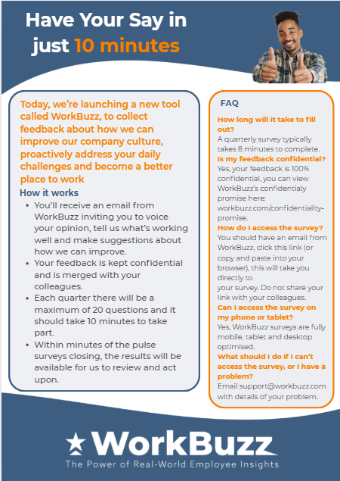



We provide pre-survey communication examples, helping to embed WorkBuzz in your culture
You can find communications templates for you to edit and use as you see fit:

Slide 13

Thank you!

